Slide 1

Advanced NLP (Fature Extraction)
NLP
Dr. Sajarwo Anggai, S.ST., M.T. NIDN : 0421108703

Slide 2
NLP Pipeline
Text Preprocessing
Feature Extraction
Modeling
Post-Processing
Deployment
Segmentation/ Tokenization
Normalization/ Lowercasing
Stopword Removal
Punctuation Removal
Stemming/ Lemmatization
Depedency parsing
Part-of-Speech Tagging
Bag of Words (BoW)
TF-IDF
Word Embeddings
Machine Learning
Deep Learning
Prediction
Evaluation
Fine-Tuning
Production
Monitoring and Updating

Slide 3
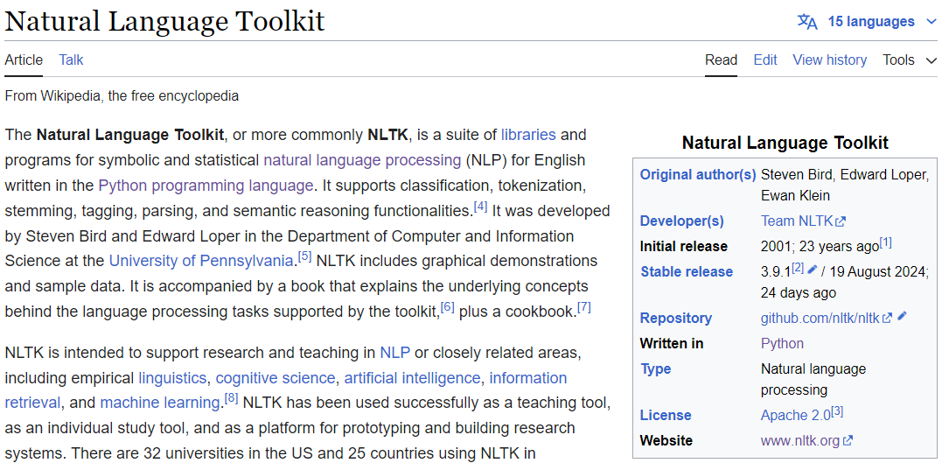
Natural Language Toolkit - NLTK
https://en.wikipedia.org/wiki/Natural_Language_Toolkit

Slide 4
Normalization/ Lowercasing
sentences = [
"Saya suka belajar data science.",
"Python adalah bahasa pemrograman yang populer.",
"Saya menggunakan Python untuk analisis data.",
"Analisis data membantu dalam pengambilan keputusan.",
"Machine learning adalah cabang dari kecerdasan buatan.",
"Algoritma machine learning bisa memprediksi hasil.",
"Saya tertarik pada teknologi baru.",
"Kecerdasan buatan memiliki banyak aplikasi.",
"Belajar data science sangat menarik.",
"Saya mengikuti kursus online tentang machine learning."
]

Slide 5
preprocess_text function (pertemuan 3)
def preprocess_text(text):
text = text.lower()
text = text.translate(text.maketrans("", "", string.punctuation))
tokens = word_tokenize(text)
stop_words = set(stopwords.words('english'))
filtered_tokens = [word for word in tokens if word not in stop_words and word.isalnum()]
ps = PorterStemmer()
stemmed_tokens = [ps.stem(word) for word in filtered_tokens]
lemmatizer = WordNetLemmatizer()
lemmatized_tokens = [lemmatizer.lemmatize(word) for word in filtered_tokens]
pos_tagged_tokens1 = pos_tag(stemmed_tokens)
pos_tagged_tokens2 = pos_tag(lemmatized_tokens)
return {
"original_text": text,
"tokens": tokens,
"filtered_tokens": filtered_tokens,
"stemmed_tokens": stemmed_tokens,
"lemmatized_tokens": lemmatized_tokens,
"pos_tagged_tokens1": pos_tagged_tokens1,
"pos_tagged_tokens2": pos_tagged_tokens2,
}

Slide 6
preprocess_text function
def preprocess_text(text):
text = text.lower()
text = text.translate(text.maketrans("", "", string.punctuation))
text = re.sub(r'\W', ' ', text)
words = word_tokenize(text)
stop_words = set(stopwords.words('indonesian'))
words = [word for word in words if word not in stop_words]
stemmer = PorterStemmer()
words = [stemmer.stem(word) for word in words]
return ' '.join(words)
preprocessed_sentences = [preprocess_text(sentence) for sentence in sentences]

Slide 7
Vectorizer
vectorizer = CountVectorizer()
X_bow = vectorizer.fit_transform(preprocessed_sentences)
print("Vocabulary:\n", vectorizer.get_feature_names_out())
print('\nVector vocabulary:\n',vectorizer.vocabulary_)
print("\nBag of Words:\n", X_bow.toarray())

Slide 8
Vectorizer (Output)
Vocabulary: ['algoritma' 'analisi' 'aplikasi' 'bahasa' 'belajar' 'buatan' 'cabang' 'data' 'hasil' 'kecerdasan' 'keputusan' 'kursu' 'learn' 'machin' 'membantu' 'memiliki' 'memprediksi' 'menarik' 'mengikuti' 'onlin' 'pemrograman' 'pengambilan' 'popul' 'python' 'scienc' 'suka' 'teknolog' 'tertarik’]
Vector vocabulary: {'suka': 25, 'belajar': 4, 'data': 7, 'scienc': 24, 'python': 23, 'bahasa': 3, 'pemrograman': 20, 'popul': 22, 'analisi': 1, 'membantu': 14, 'pengambilan': 21, 'keputusan': 10, 'machin': 13, 'learn': 12, 'cabang': 6, 'kecerdasan': 9, 'buatan': 5, 'algoritma': 0, 'memprediksi': 16, 'hasil': 8, 'tertarik': 27, 'teknolog': 26, 'memiliki': 15, 'aplikasi': 2, 'menarik': 17, 'mengikuti': 18, 'kursu': 11, 'onlin': 19}
Bag of Words:
[[0 0 0 0 1 0 0 1 0 0 0 0 0 0 0 0 0 0 0 0 0 0 0 0 1 1 0 0]
[0 0 0 1 0 0 0 0 0 0 0 0 0 0 0 0 0 0 0 0 1 0 1 1 0 0 0 0]
[0 1 0 0 0 0 0 1 0 0 0 0 0 0 0 0 0 0 0 0 0 0 0 1 0 0 0 0]
[0 1 0 0 0 0 0 1 0 0 1 0 0 0 1 0 0 0 0 0 0 1 0 0 0 0 0 0]
[0 0 0 0 0 1 1 0 0 1 0 0 1 1 0 0 0 0 0 0 0 0 0 0 0 0 0 0]
[1 0 0 0 0 0 0 0 1 0 0 0 1 1 0 0 1 0 0 0 0 0 0 0 0 0 0 0]
[0 0 0 0 0 0 0 0 0 0 0 0 0 0 0 0 0 0 0 0 0 0 0 0 0 0 1 1]
[0 0 1 0 0 1 0 0 0 1 0 0 0 0 0 1 0 0 0 0 0 0 0 0 0 0 0 0]
[0 0 0 0 1 0 0 1 0 0 0 0 0 0 0 0 0 1 0 0 0 0 0 0 1 0 0 0]
[0 0 0 0 0 0 0 0 0 0 0 1 1 1 0 0 0 0 1 1 0 0 0 0 0 0 0 0]]

Slide 9
TF-IDF
tfidf_vectorizer = TfidfVectorizer()
X_tfidf = tfidf_vectorizer.fit_transform(preprocessed_sentences)
print("Vocabulary:\n", tfidf_vectorizer.get_feature_names_out())
print('\nVector vocabulary:\n',tfidf_vectorizer.vocabulary_)
print("\nTF-IDF:\n", X_tfidf.toarray())

Slide 10
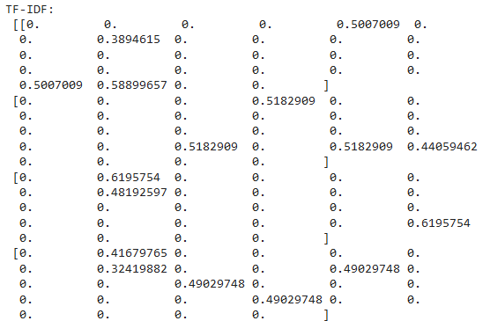
TF-IDF (Output)
Vocabulary: ['algoritma' 'analisi' 'aplikasi' 'bahasa' 'belajar' 'buatan' 'cabang' 'data' 'hasil' 'kecerdasan' 'keputusan' 'kursu' 'learn' 'machin' 'membantu' 'memiliki' 'memprediksi' 'menarik' 'mengikuti' 'onlin' 'pemrograman' 'pengambilan' 'popul' 'python' 'scienc' 'suka' 'teknolog' 'tertarik’]
Vector vocabulary: {'suka': 25, 'belajar': 4, 'data': 7, 'scienc': 24, 'python': 23, 'bahasa': 3, 'pemrograman': 20, 'popul': 22, 'analisi': 1, 'membantu': 14, 'pengambilan': 21, 'keputusan': 10, 'machin': 13, 'learn': 12, 'cabang': 6, 'kecerdasan': 9, 'buatan': 5, 'algoritma': 0, 'memprediksi': 16, 'hasil': 8, 'tertarik': 27, 'teknolog': 26, 'memiliki': 15, 'aplikasi': 2, 'menarik': 17, 'mengikuti': 18, 'kursu': 11, 'onlin': 19}

Slide 11
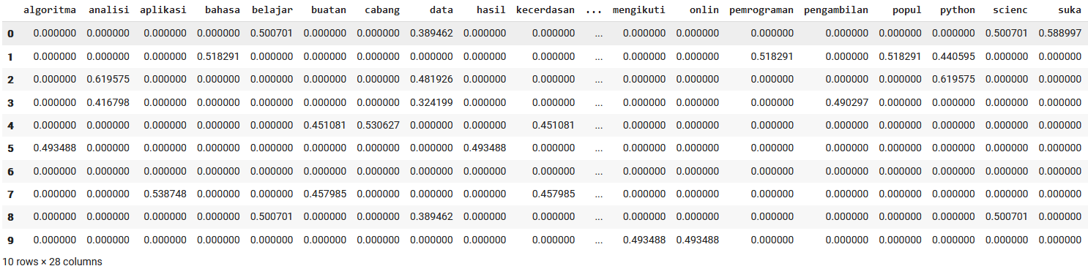
TF-IDF (Output dengan Pandas)
# Convert to a DataFrame
import pandas as pd
tfidf_df = pd.DataFrame(X_tfidf.toarray(), columns=tfidf_vectorizer.get_feature_names_out())
tfidf_df

Slide 12
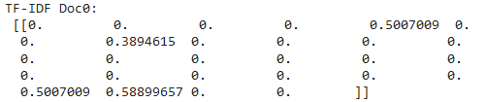
TF-IDF – Per Doc (Output)
print("\nTF-IDF:\n", X_tfidf.toarray())
print("\nTF-IDF Doc0:\n", X_tfidf[0].toarray())

Slide 13
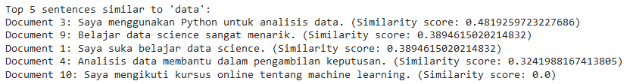
Cosine Similarity 1
query = "data"
query_vector = tfidf_vectorizer.transform([query])
cosine_similarities = cosine_similarity(query_vector, X_tfidf)
similarity_scores = cosine_similarities[0]
sorted_indices = np.argsort(similarity_scores)[::-1]
top_5_indices = sorted_indices[:5]
print("Top 5 sentences similar to 'data':")
for index in top_5_indices:
print(f"Document {index + 1}: {sentences[index]} (Similarity score: {similarity_scores[index]})")

Slide 14
Cosine Similarity 2
cosine_similarities = cosine_similarity(query_vector, X_tfidf).flatten()
# Mengurutkan dokumen berdasarkan cosine similarity score secara descending
related_docs_indices = cosine_similarities.argsort()[::-1]
# Menampilkan dokumen dan skornya
print("Sentences similar to 'data':\n")
for i in related_docs_indices:
print(f"Document {i + 1}: {sentences[i]}")
print(f"Similarity Skor: {cosine_similarities[i]:.4f}")
print("-" * 20)

Slide 15
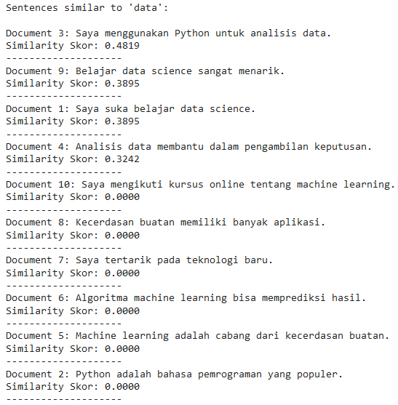
Cosine Similarity 2 (Output)

Slide 16
Ref Tambahan
https://medium.com/@hckecommerce/essential-nlp-feature-extraction-methods-1ff7cb4dc9f1
https://www.analyticsvidhya.com/blog/2022/05/a-complete-guide-on-feature-extraction-techniques/
https://www.geeksforgeeks.org/feature-extraction-techniques-nlp/
https://medium.com/@eskandar.sahel/exploring-feature-extraction-techniques-for-natural-language-processing-46052ee6514

Slide 17
Tugas
Cari 10 jurnal terkait dengan perkembangan Feature Extraction di NLP
Buatlah program untuk melakukan Feature Extraction pada corpus/dataset

Slide 18

Universitas Pamulang
Prodi Teknik Informatika S-2
Sajarwo Anggai
Dosen – Universitas Pamulang
NIDN : 0421108703
Email : dosen02832@unpam.ac.id
Terima Kasih

